Slide 1
WEB SCIENCE The History of Social Networks
Group 1
Li Zhiqiang
Liu Xupeng
Rao Chencheng
Chen Haoran

Slide 2
Contents
1. The Definition of Social Networks
2. Social Networks Before 1900
3. Social Networks in the 20th Century
4. Social Networks in Today
5. History of Social Networks in China
6. Social Networks in Education & AI
7. Virtual Reality and Augmented Reality: The Future of Social Networking

Slide 3
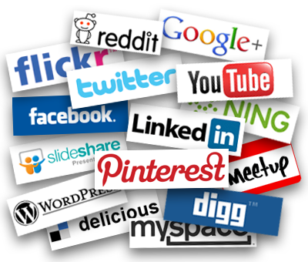
1. Definition of Social Networks
a network of individuals (such as friends, acquaintances, and coworkers) connected by interpersonal relationships
an online service or site through which people create and maintain interpersonal relationships
Notes:
From the 1st definition

Slide 4
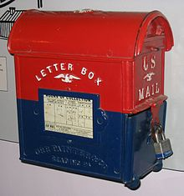
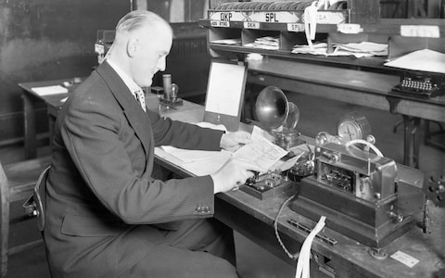
2. Social Networks Before 1900
The earliest form of postal service dates back to 550 B.C
In 1792, the telegraph was invented.
The telephone in 1890 and the radio in 1891.
Notes:
Social networks without internet in other countries.
This allowed messages to be delivered over a long distance far faster than a horse and rider could carry them. Although telegraph messages were short, they were a revolutionary way to convey news and information.
Two important discoveries happened in the last decade of the 1800s: The telephone in 1890 and the radio in 1891.
Both technologies are still in use today, although the modern versions are much more sophisticated than their predecessors. Telephone lines and radio signals enabled people to communicate across great distances instantaneously, something that mankind had never experienced before.

Slide 5


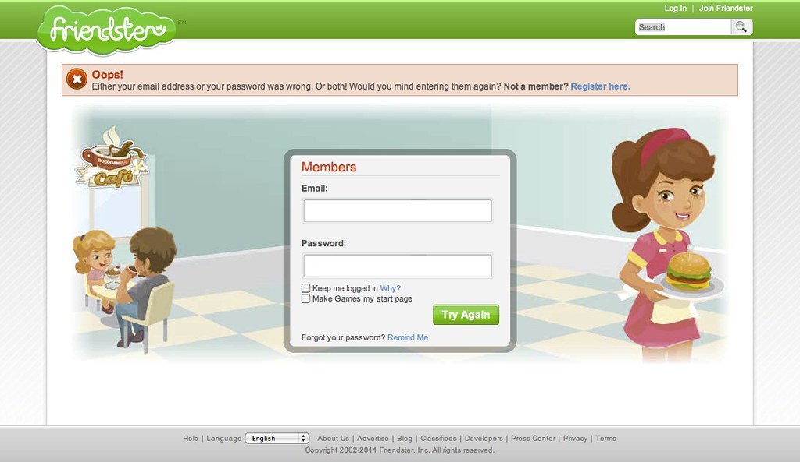
3. Social Networks in the 20th Century
In the 1940s, the first super computers were created
The first recognizable social media site, Six Degrees, was created in 1997.
Notes:
Technology began to change very rapidly in the 20th Century. After the first super computers were created in the 1940s, scientists and engineers began to develop ways to create networks between those computers, and this would later lead to the birth of the Internet.
The earliest forms of the Internet, such as CompuServe, were developed in the 1960s. Primitive forms of email were also developed during this time. By the 70s, networking technology had improved, and 1979’s UseNet allowed users to communicate through a virtual newsletter.
By the 1980s, home computers were becoming more common and social media was becoming more sophisticated. Internet relay chats, or IRCs, were first used in 1988 and continued to be popular well into the 1990’s.
The first recognizable social media site, Six Degrees, was created in 1997. It enabled users to upload a profile and make friends with other users. In 1999, the first blogging sites became popular, creating a social media sensation that’s still popular today.
It was officially launched in 1997, and it lasted until about 2001. It’s number of users peaked at around 3.5 million. It was bought out by YouthStream Media Networks in 1999 for $125 million, but it shut down just one year later.

Slide 6


4. Social Networks in Today
A few years later, in 2002, the site Friendster emerged to compete with Six Degrees.
LinkedIn was founded on December 28, 2002.
Facebook was founded on February 4, 2004
Notes:
LinkedIn it was a site focused on professional networking, allowing people to connect with business and school contacts, as well as companies.

Slide 7

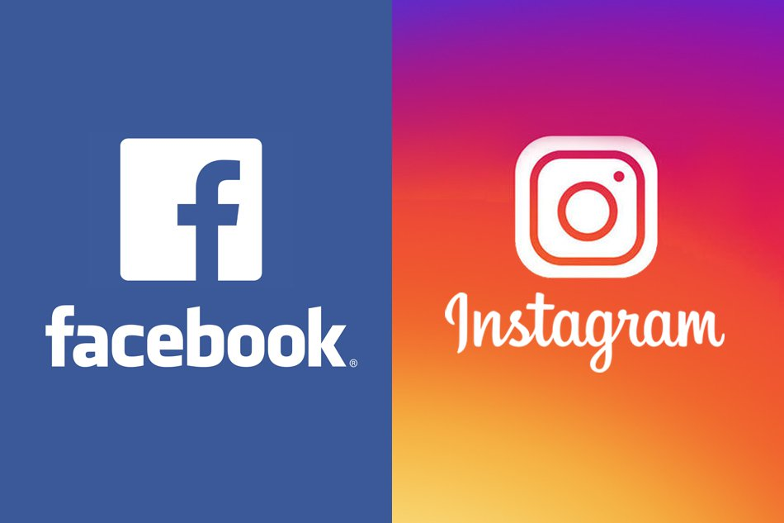

4. Social Networks in Today
YouTube came out in 2005.
Twitter was created on March 21, 2006.
Instagram launched on October 6, 2010.
Facebook bought Instagram, for approximately $1 billion in cash and stock.
Notes:
LinkedIn it was a site focused on professional networking, allowing people to connect with business and school contacts, as well as companies.

Slide 8
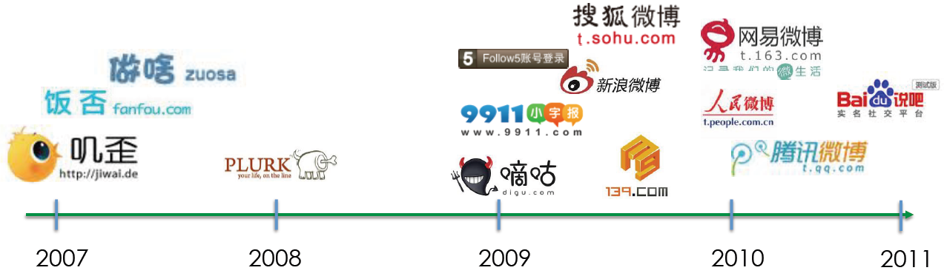
5. History of Social Networks in China
In China, three of the hottest social media platforms are WeChat, QQ and Weibo.
Before 2000, it was the development period of China's first generation of social products. The most typical representative was Tencent's QQ in 1998, which imitated OICQ.

Slide 9

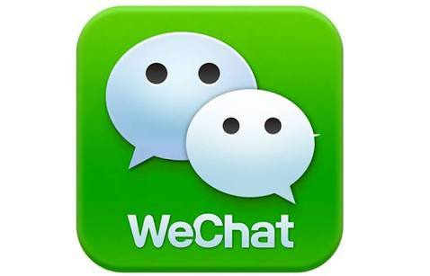

5. History of Social Networks in China
WeChat is an instant messaging app with nearly 500 million active users in China.
QQ launched 18 years ago and recently rebranded itself to focus on entertainment and subcultures among China’s youth, with features similar to Snapchat

Slide 10


5. History of Social Networks in China
Weibo is often called China’s Twitter. However, in terms of pure numbers, the network appears to have overtaken Twitter, with 340 million active users to Twitter’s 328 million. One key reason for this growth has been the evolution of the service into to a multimedia blogging platform, with features similar to those found on Twitter, Pinterest and Tumblr combined. First Weibo launched in 2008 and were practically Twitter clones.

Slide 11


6. Social Networks in Education & AI
Fact extraction resource constructed by knowledge atlas
Emotional analysis, perspective mining raw materials
Language study
Promote information retrieval and knowledge extraction research

Slide 12

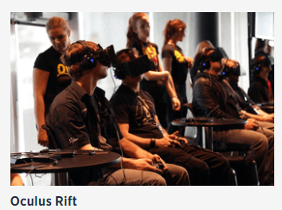
7. Virtual Reality and Augmented Reality: The Future of Social Networking
In March 2014, Facebook acquired Oculus VR, a company on the cusp of mass producing virtual-reality headsets.
Smartphones are more than capable of delivering augmented reality, and as one might expect, the technology is the entire concept driving Google Glass’ digital integration with the real world

Slide 13


